Slide 1

DEPARTMENT OF COMPUTER SCIENCE AND ENGINEERING
Project Name: Smart Water Fountain
Team Name: Proj_224781_Team_3
Team Members:
UDAY PRATAP V M(113321104103)
VADDIBOINA PATTABHIRAMI REDDY (113321104105)
VAKATI VIKRAM ADITAYA REDDY (113321104109)
VATRAPU VISHNU VARDHAN REDDY (113321104111)

Slide 2
INNOVATION
Smart Control : Implement IoT technology for remote control and scheduling of fountain operation.
Water Recycling: Integrate a closed-loop water recycling system to minimize water usage.
Music and Light Synchronization: Sync fountain displays with music and lighting for captivating shows.
Water Quality Sensors: Use sensors to monitor water quality and adjust purification processes as needed.
Augmented Reality (AR) Features: Create an AR app that provides information about the fountain's history, design, and more when visitors point their smartphones at it.
Security Measures: Ensure that the smart fountains have robust cybersecurity measures to protect user data and prevent hacking.
Integration with Smart Cities: Enable integration with smart city infrastructure, so that data from the fountains can be used to optimize water distribution and quality management in the city.

Slide 3
OBJECTIVES
Water Conservation: Design fountains that use water efficiently, minimizing waste.
Aesthetic Enhancement: Create visually appealing fountains that enhance the beauty of public parks and gardens.
Environmental Sustainability: Implement eco-friendly features like solar-powered pumps and LED lighting.
Maintenance Efficiency: Develop a system that monitors and reports.
Water Quality: Maintain water quality through filtration and purification systems.
Data Analytics: Collect data on fountain usage and visitor preferences to improve the overall experience.
Water Feature Variety: Create fountains with various water features like misting, spraying, and cascading for diversity.

Slide 4
REQUIREMENTS
Fountain Design: Collaborate with architects and designers to create aesthetically pleasing fountain structures that fit the park's theme.
Water Management System: Install pumps, filters, and reservoirs for efficient water circulation and filtration.
Sensors: Use water quality sensors, temperature sensors, and weather sensors to gather data for monitoring and control.
Control System: Develop a user-friendly control interface, which can be a smartphone app or a touch panel at the park.
Water Recycling: Implement a water recycling system to minimize water wastage.

Slide 5
Safety Measures: Ensure safety features like water depth sensors and emergency shut-off mechanisms.
Weatherproofing: Design the fountain and its components to withstand various weather conditions.
Maintenance Protocol: Establish a maintenance schedule and integrate sensors to provide alerts for maintenance needs.
Energy Management: Utilize energy-efficient components and consider renewable energy sources such as solar panels.

Slide 6
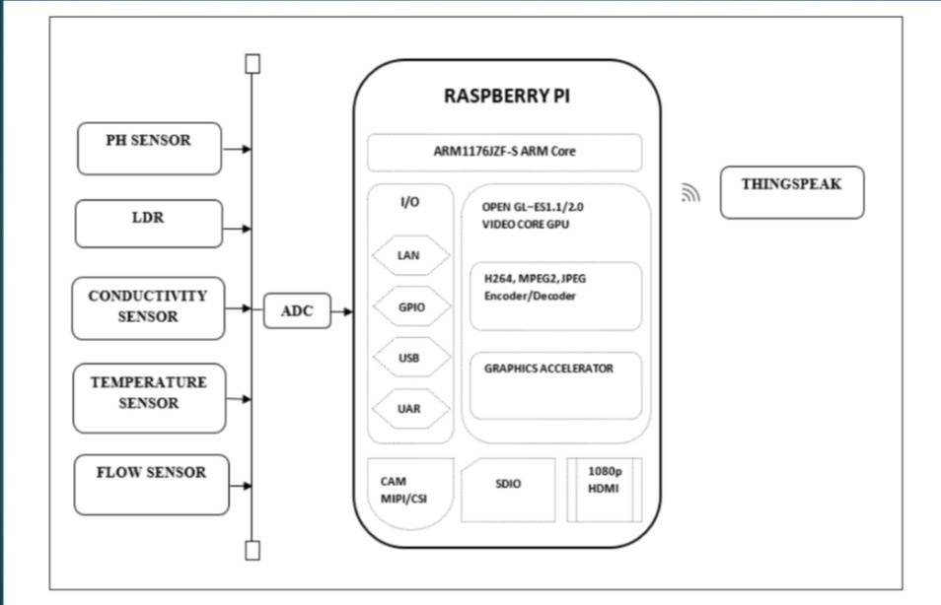
RASPBERRY PI INTEGRATION

Slide 7
CODE IMPLEMENTATION
int trigPin=12;
int echoPin=10;
int vcc=13;
int gnd=10;
void setup()
{
Serial.begin(9600);
pinMode(trigPin, OUTPUT);
pinMode(echoPin, INPUT);
pinMode(vcc, OUTPUT);
pinMode(gnd, OUTPUT);
digitalWrite(vcc, HIGH);
digitalWrite(gnd, LOW);
}
void loop()
{
long duration,distance;
digitalWrite(trigPin, HIGH);
delayMicroseconds(10);
digitalWrite(trigPin, LOW);
delayMicroseconds(10);
distance=(duration*0.034/2) + 1;
Serial.println("Distance = "+ String(distance));
delay(1000);
if(distance<100)
{
Serial.println("High");
digitalWrite(1, HIGH);
delay(1000);
}
else
{
Serial.println("Low");
digitalWrite(1, LOW);
delay(1000);
}
}

Slide 8
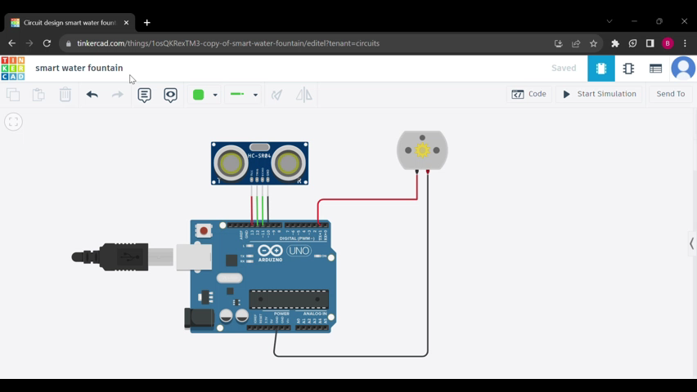

Slide 9
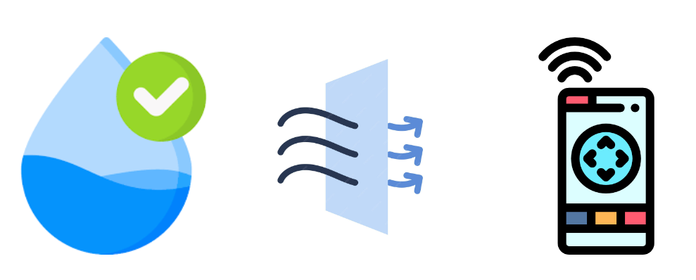
Check the below link to access the overview of smart water fountain
https://smart-water-fountain.netlify.app/

Slide 10
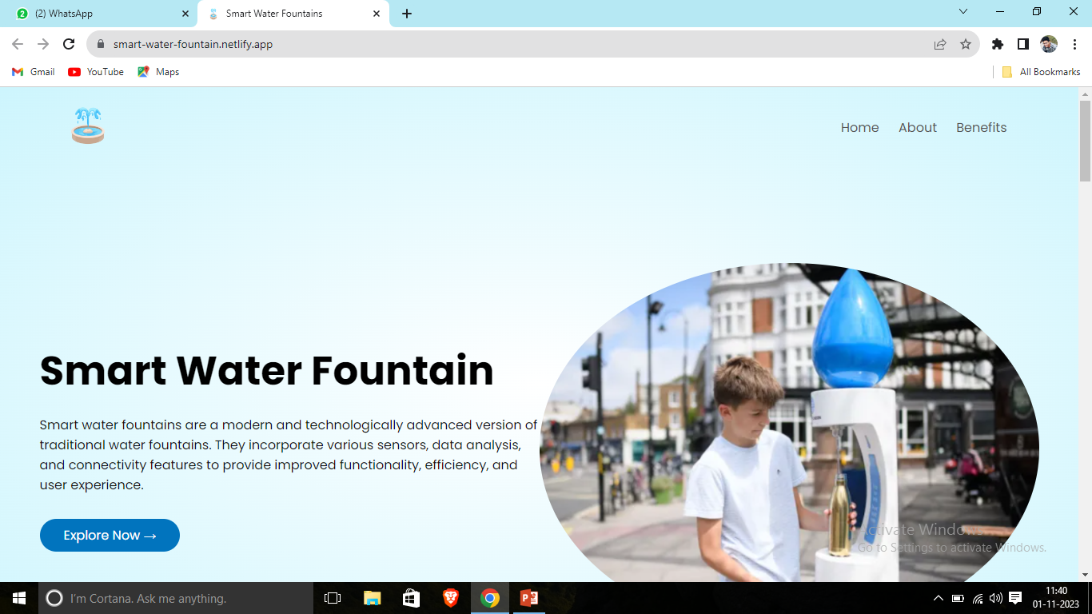
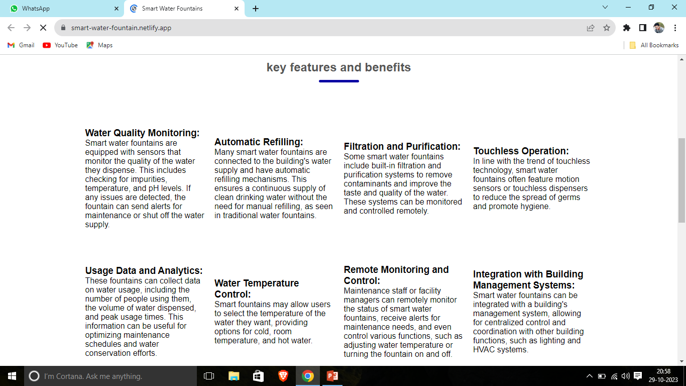
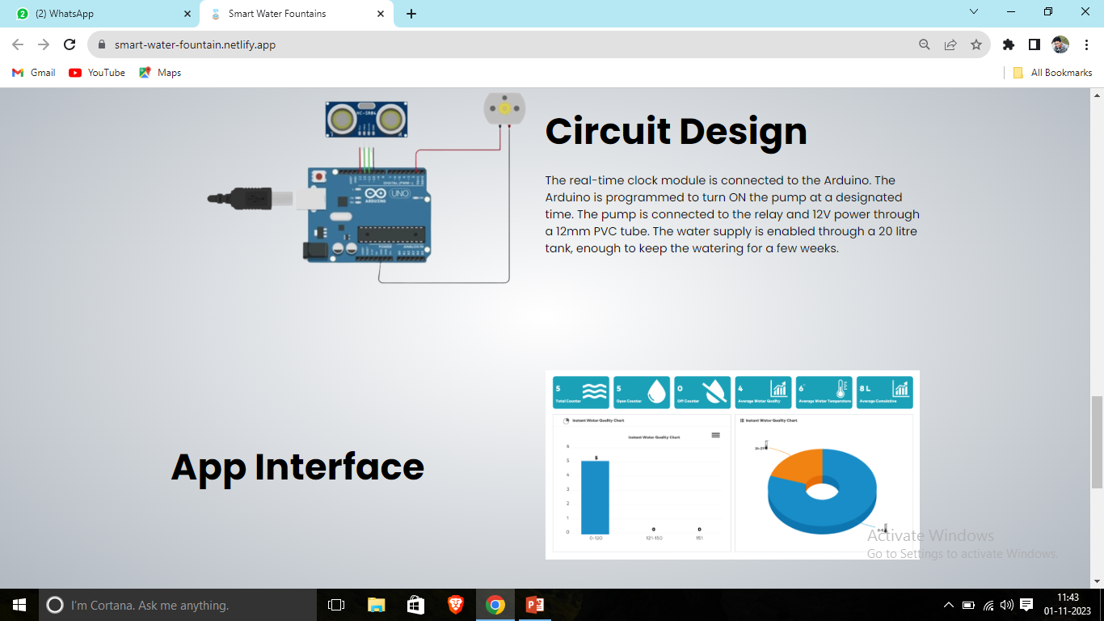
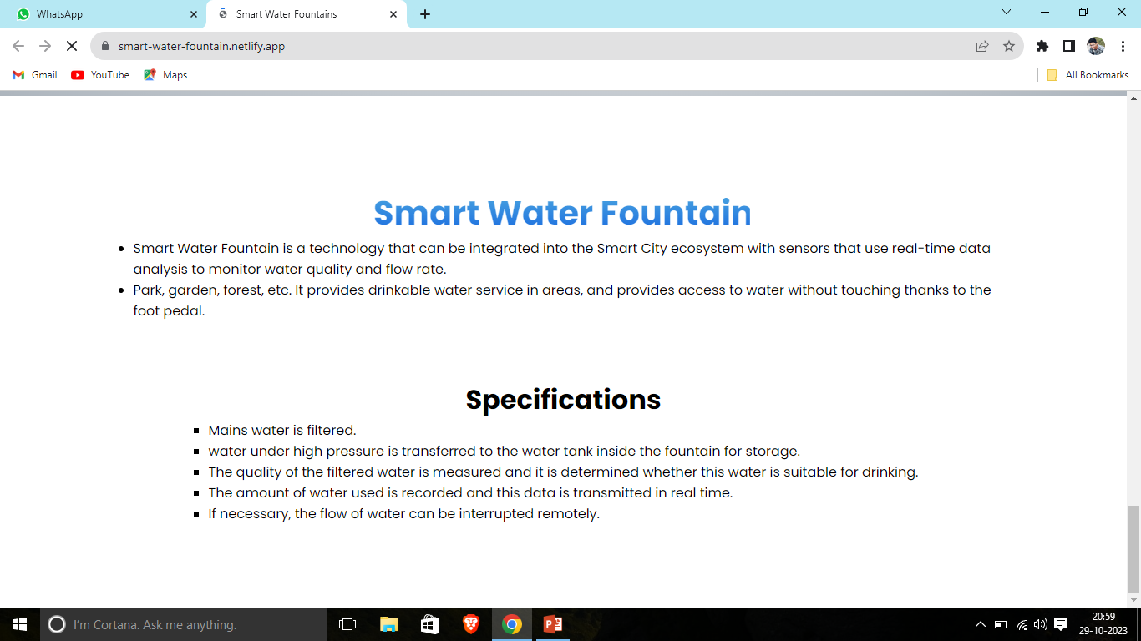
SCREENSHOT OF THE WEBSITE

Slide 11
CONCLUSION
The 'Smart Water Fountains' project has successfully transformed public parks and gardens into vibrant, sustainable, and interactive spaces that delight and engage visitors.
The 'Smart Water Fountains' project is not just about water features but also about creating a hub for research, education, and community gathering.
As a result, these fountains have become more than decorative elements; they have become community landmarks, promoting interaction, environmental stewardship, and cultural enrichment.

Slide 12
THANK YOU

